Slide 1



SMART INDIA HACKATHON 2025
Problem Statement ID: SIH250270
Problem Statement Title: AyuLink: Blockchain-Based Traceability System for Ayurvedic Herbs
Theme: Blockchain & Cybersecurity
PS Category: Software
Team ID: The Root Coders
Team Name: The Root Coders

Slide 2
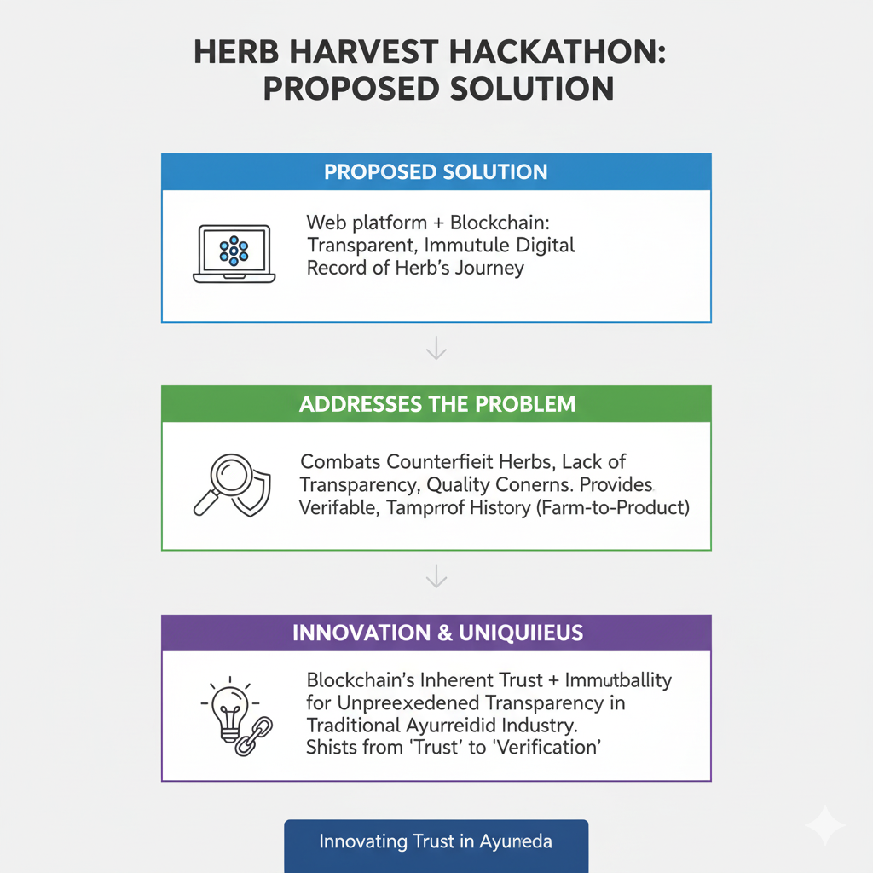
AyuLink: Blockchain-Based Traceability System for Ayurvedic Herbs
The Root Coders
• Proposed Solution: We are developing a web platform that uses blockchain technology to create a transparent and immutable digital record of an Ayurvedic herb's journey.
• How it addresses the problem: It directly combats the issues of counterfeit herbs, lack of transparency, and quality concerns by providing a verifiable, tamper-proof history for each batch, from the farm to the final product.
• Innovation and uniqueness: The core innovation is using the inherent trust and immutability of blockchain to bring unprecedented transparency to the traditional Ayurvedic industry, a sector that currently relies heavily on trust with little verification
@SIH Idea submission- Template
Notes:
null

Slide 3
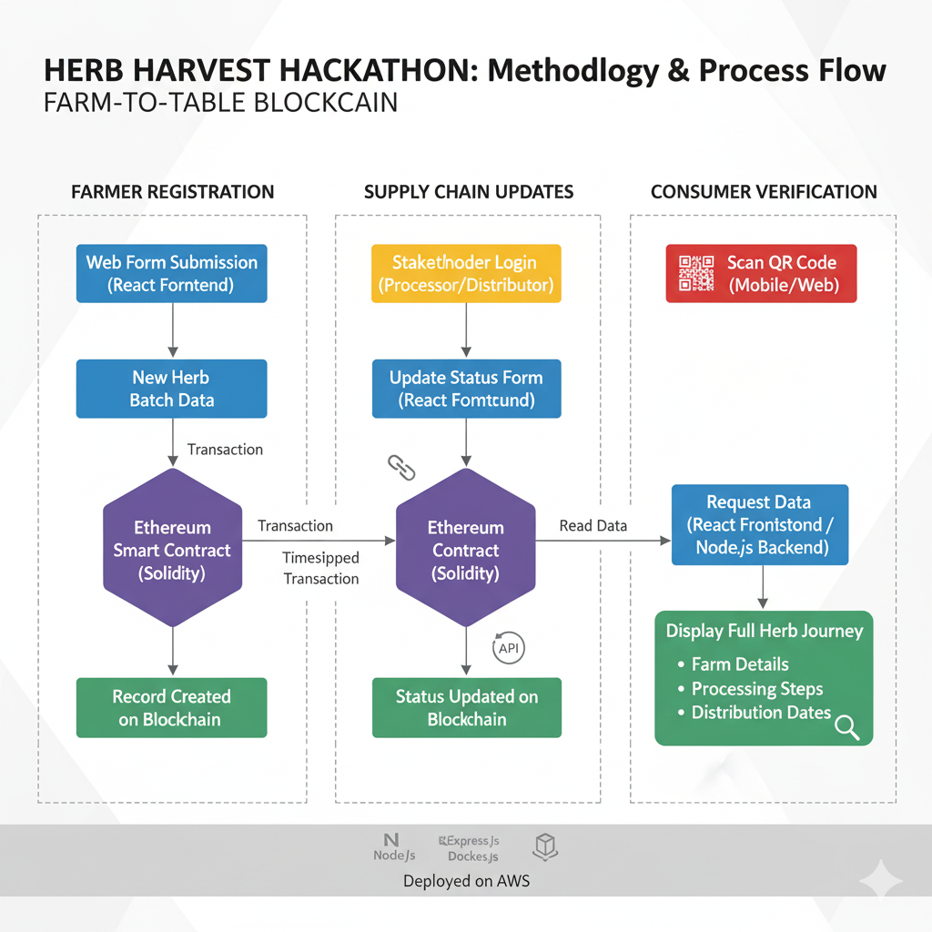
TECHNICAL APPROACH
The Root Coders
@SIH Idea submission- Template
Notes:
null

Slide 4
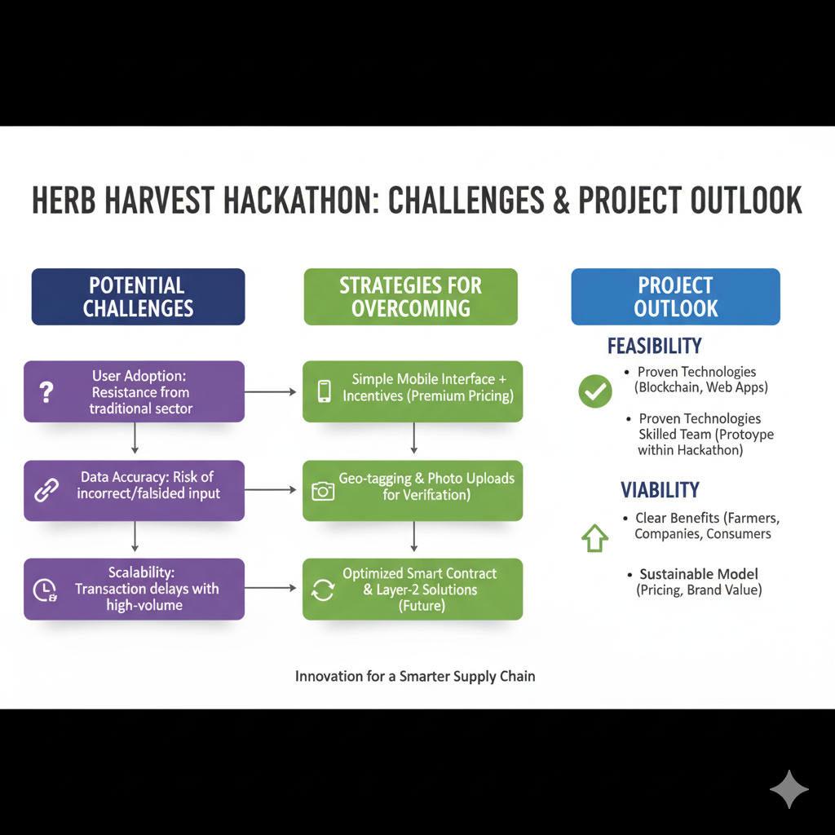
FEASIBILITY AND VIABILITY
The Root Coders
@SIH Idea submission- Template
Notes:
null

Slide 5
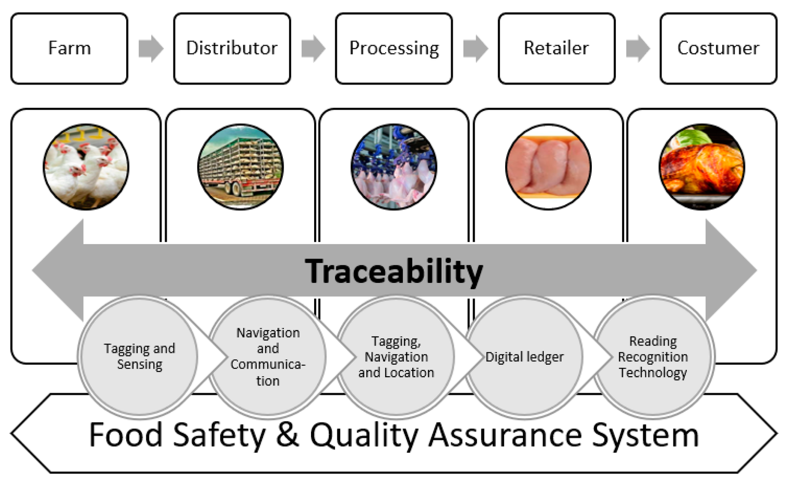
IMPACT AND BENEFITS
The Root Coders
Potential impact on the target audience:
Consumers: QR-code enabled traceability & digital authenticity certificates
Farmers: Proof-of-origin on blockchain → premium pricing + faster payments (via UPI/crypto wallets)
Companies: Anti-counterfeit protection, automated compliance reporting (AYUSH/FSSAI)
Benefits of the solution:
Social: Trust in Ayurveda
Economic: Premium market & tokenized incentives
Environmental: Sustainable harvesting via geo-tag transparency
@SIH Idea submission- Template
Notes:
null

Slide 6
RESEARCH AND REFERENCES
The Root Coders
1.Market Research:
Ministry of Ayush & WHO reports → highlight global growth of traditional medicine
Identified major issues: adulteration & counterfeiting in supply chain
2.Technical Research: Analyzed existing blockchain-based supply chain solutions in other industries (e.g., food, diamonds) to understand best practices. Key technologies researched include Ethereum, Solidity, and decentralized identity (DID) principles.
3.Feasibility Study:
The Hindu (https://www.thehindu.com/news/national/most-herbal-products-in-market-adulterated-say-experts/article65983582.ece)
MDPI (https://www.mdpi.com/2071-1050/13/4/2083)
4.References:
Ayush Website (https://www.ayush.gov.in/)
NAM Guidelines (https://nam.gov.in/sites/default/files/NAM-Guideline.pdf)
IEEE (https://ieeexplore.ieee.org/)
@SIH Idea submission- Template
Notes:
null

